Slide 1
Welcome, Parents of the ORHS Class of 2023

Slide 2
Agenda
Introductions
Oak Ridge High School Highlights
“A Day in the Life” of a 9th Grade Student at Oak Ridge HS
Important Policies/Rules
Nurse Information
Counseling Services

Slide 3
Introductions

Slide 4
Administration - Oak Ridge High School 9th Grade
Melanie Bujnoch, Principal - ORHS 9th Grade Campus
Danny Barber - Associate Principal
ACES Students
Alaina Adams - Assistant Principal
Class of 2023 Cohort
Dr. Michael Papadimitriou - ACES Headmaster Michael Papadimitriou Michael Papadimitriou

Slide 5
Administration - Oak Ridge High School Main Campus
Dr. AJ LiVecchi - Principal
Associate Principals:
Shawn Almond
Jan Lewis
Assistant Principals:
Vincent Cue
Chris Dungan
Heath Manuel
Danielle Smith
Kevin Solberg

Slide 6
Counselors
Mrs. Mamie Prejean - Lead Counselor
9th Grade Campus
Melissa Thetford
Last Names A - K
Cathey Costas
Last Names L - Z
Main Campus
Karen Town
Molly Gibson
Beth Graham
Rachelle Perry
Shawn Matlock
Reagan Locke
Christine McLaughlin
Dena Alvarez

Slide 7
Oak Ridge High School Highlights

Slide 8
Mission Statement
CISD and ORHS are a part of a learning community united in its commitment to ensuring that all students graduate with confidence and competence.
Oak Ridge High School will accept the responsibility to provide an educational environment for all students to:
Strive to achieve their highest level of academic achievement
Operate as responsible citizens in a rapidly-changing world now and in the 21st century
Awaken a positive image of self and others
Recognize that education is not received but achieved

Slide 9
Celebrations
Graduated over 920 seniors last year with over $8 million dollars in college scholarships
Increases in SAT, ACT, and AP scores for each of the last 3 years
Highest mastery rate on Algebra I End of Course Exam in Conroe ISD
9th Grade EOC Passing Rates
English I - 85% - 2nd Overall, Increases in Mastery each of the last 3 years
Algebra I - 90% - 2nd Overall, increases in Mastery each of the last 3 years
Biology - 94% - 3rd Overall , increases in Mastery each of the last 3 years

Slide 10
Celebrations
Marching Band, Choir, and Orchestra all made sweepstakes for the second year in a row (only HS in CISD to do it both years)
Marching Band went to state for first time in ORHS History as a 6A school and only second time in school history overall
Several all staters in band and orchestra
Cheerleaders 2nd in UIL competition (state) in 2019
Volleyball, Girls Basketball, Girls Soccer, Softball, Baseball, made playoffs
Several individual athletes participated in state competitions (golf, swim, dive)
Girls Bowling Team won regionals and finished 2nd in state competition
Water Polo had an excellent season

Slide 11
Celebrations
Level I and Level II High Reliability Schools Certified School by Marzano Research Group.
We are the largest comprehensive High School to be certified on Level I or Level II.
Level 1 - Safe, supportive, and collaborative culture
Level 2 - Effective teaching in every classroom

Slide 12
“A Day in the Life” of a ORHS 9th Grade Student

Slide 13
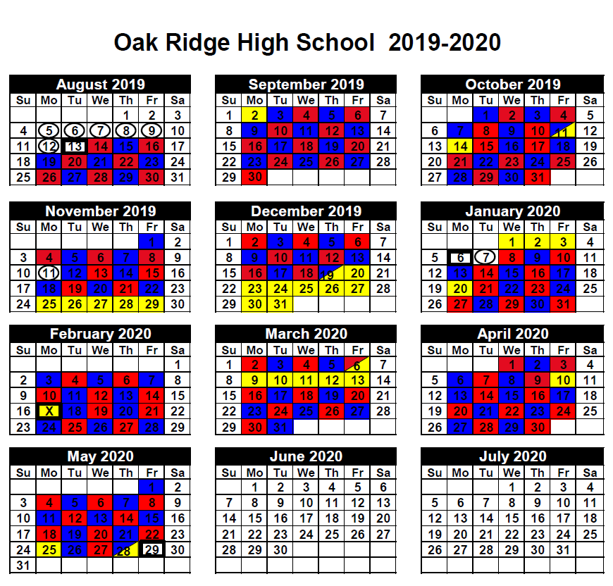
Red/Blue Day Block Schedule

Slide 14
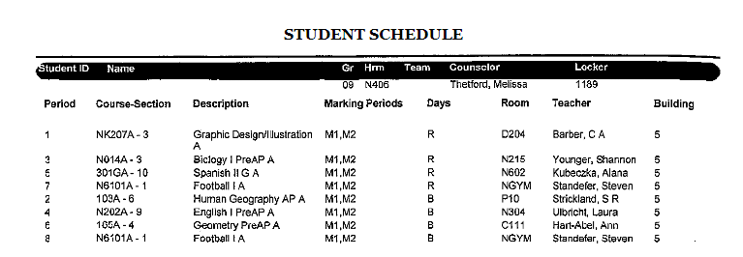
Class Schedule
Michael Papadimitriou Michael Papadimitriou

Slide 15
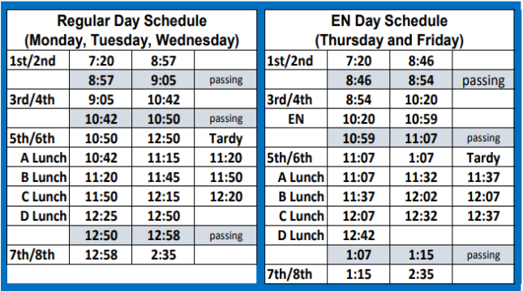
Bell Schedule
Michael Papadimitriou Michael Papadimitriou

Slide 16
Eagle’s Nest
Academic tutorial time during school on Thursday and Friday
Students may request a pass from a teacher or stay in their class and work on homework

Slide 17
Drop off/Pick up
All students should be dropped off and picked up at the front of the school. The back is for bus riders only.
Students should be dropped off on the campus where their first class is located
The last time to pick up a student before the end of the day is 2:15.

Slide 18
Lunch
No outside food deliveries are allowed (UberEats, Door Dash, etc.)
Parents can drop off food in the front office
No visitors are allowed to eat lunch with students during lunch time
Michael Papadimitriou Michael Papadimitriou

Slide 19
Busses
Busses leave 8 minutes after the last bell.
Busses drop off on both campuses in the morning but only depart from the senior campus after school.
Michael Papadimitriou Michael Papadimitriou

Slide 20
Tutorials
After school tutorial schedules will be available once school starts.
Students can go to any teacher offering tutorials for the course

Slide 21
Important Rules and Procedures

Slide 22
Electronic Device Policy
Electronic devices are only allowed before school, after school, during passing periods, and lunches.
They may only be used during class for instructional purposes at teacher’s discretion.

Slide 23
Tardies
Students receive their 1st consequence after 7 tardies.
The accumulation of tardies starts over each grading period.
Parents are emailed through Parent Access after each tardy.
If a student is more than 15 minutes late to class, they are marked absent.
Michael Papadimitriou Michael Papadimitriou

Slide 24
Dress Code
Most frequent dress code concerns:
Holes in jeans cannot be higher than 4” above the knee or tights must be worn under the jeans
No hoods or hats are allowed
Midriff must be covered at all times
Shorts must be clearly visible
Michael Papadimitriou Michael Papadimitriou

Slide 25
Attendance
Absence Phone Number: 281-465-5012
Notes should be given to the attendance office within 5 days of the absence (email, fax, or hand delivered)
Attendance in high school is important! Students can lose credit for each class if they have excessive absences.

Slide 26
Kid Chat
Login: conroeisd

Slide 27
Clinic Information

Slide 28
Clinic Information
Our nurse is Pam Eakin R.N.
(281) 465-5016
Health History Form
Medications
Clinic Visits
Forms:
Medications
Asthma
Anaphylaxis
Seizures
Diabetes

Slide 29
Counseling Services

Slide 30
Counseling Services
Freshman Parent Night
September 23, 2019
6pm

Slide 31
Welcome to the Oak Ridge Family!

Slide 32
Follow us on social media!
@ORWarEagles
@ORHS_Principal
@melanie_bujnoch
@RidgeCounselors
Place your screenshot here

Slide 33
Thank you
Any questions?
You can reach me at
mbujnoch@conroeisd.net

